Slide 1
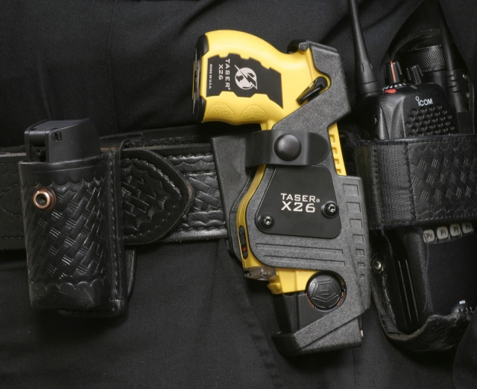
Tasers
By: Caitlin Murphy

Slide 2
Info On Tasrers.
1.) How do they work ?
2.) Why tasers are safe.
3.) what tasers are used for.

Slide 3
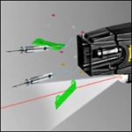
How do tasers work?
The police officer would point the taser at the person. Laser will pin point where they will be tased.
Taser is fired and sends 50,000 electric volts through the persons body.
The person is then temporarily paralyzed.
The person will be very sore after being shot by the taser.

Slide 4
Why tasers are safe
"I would say that, of the people who were Tasered, it probably saved their lives,“ Dr. Ordog king.
In kings study out of 218 victims 95% were male. 5% were female.
15% were naked…
Chance of death is around 1%

Slide 5
What tasers are used for
Safety for officer (huge guy can be taken down with one taser shot)
Safety for the person who is drunk/high/crazy
Safety for a victim if the other person is about to cause harm to someone.
More common with police force but there are people who have their own taser for protection.

Slide 6
Video
http://www.youtube.com/watch?v=JJedPx7Hr1I

Slide 7
what we learned.
How Tasers work and that they contain 50,000 eclectic volts.
They are helpful for the police in a scary situation.
Tasers will solve a problem in the safest way.

Slide 8
Contact information
Email me at cmm6002@psu.edu
ANY QUESTIONS??????

Slide 9
Work cited
Pictures/info
http://www.google.com/search?pq=history+of+early+church+in+genesis&hl=en&cp=6&gs_
id=2u&xhr=t&q=tasers&biw=511&bih=407&gs_sm=&gs_upl=&bav=on.2,or.r_gc.r_pw.,cf.osb&um=1&ie=UTF-8&tbm=isch&source=og&sa=N&tab=wi#q=tasers&um=1&hl=en&sa=N&tbm=isch&bav=on.2,or.r_gc.r_pw.,cf.osb&fp=28d9c2d16178373d&biw=1047&bih=419
video
http://www.youtube.com/watch?v=JJedPx7Hr1I
http://www.google.com/imgres?q=how+do+tasers+work&um=1&hl=en&sa=N&biw=1047&
bih=419&tbm=isch&tbnid=8ZjrmniMkZvyFM:&imgrefurl=http://www.bbc.co.uk/news/1/hi/uk/7745137.stm&docid=ety8996WMWso1M&w=466&h=204&ei=ViyOTp-qDebX0QHO6ahD&zoom=1&iact=hc&vpx=180&vpy=133&dur=38&hovh=148&hovw=340&tx=190&ty=102&page=1&tbnh=60&tbnw=136&start=0&ndsp=12&ved=1t:429,r:7,s:0
Pictures http://www.google.com/search?hl=en&cp=10&gs_id=v&xhr=t&q=how+do+tasers+work&biw=1047&bih=419&gs_sm=&gs_upl=&bav=on.2,or.r_gc.r_pw.,cf.osb&um=1&ie=UTF-
8&tbm=isch&source=og&sa=N&tab=wi#um=1&hl=en&tbm=isch&sa=1&q=taser+prongs&pbx=1&oq=taser+prongs&aq=f&aqi=g1&aql=&gs_sm=e&gs_upl=624922l630463l0l630755l29l22l0l1l1l6l286l3242l1.15.4l21l0&bav=on.2,or.r_gc.r_pw.,cf.osb&fp=dacc193fa943a3e9&biw=1047&bih=419

