Slide 1
There should be more prisons like Sheriff Joe Arpaio’s prison
By Caitlin Murphy
Study :Criminal justice
Penn State Hazelton
http://www.google.com/imgresq=prison+bars&um=1&hl=en&sa=N&biw=1047&bih=419&tbm=isch&tbnid=YgMXJkV9HrUv7M:&imgrefurl=http://theanonymousperilsofassw.blogspot.com/2010/09/behind-bars.html&docid=AOsb3_v-

Slide 2
Reasons
How the prison is different
Saves money
Make prisoners never wanting to come back

Slide 3
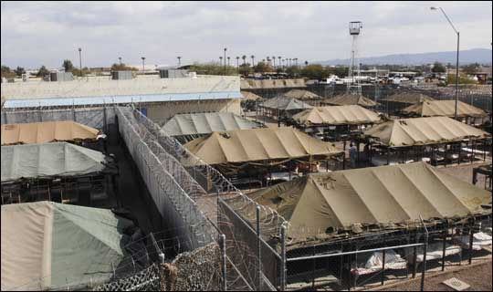
How the prison is different
Well.. Its in a tent.. In arizona
Its outdoors
Temperatures reach about 120 -130
The prisoners voluntarily work in chain gangs
http://www.tarncourt.co.uk/sillies/sillies/web/sheriff-joe.htm

Slide 4
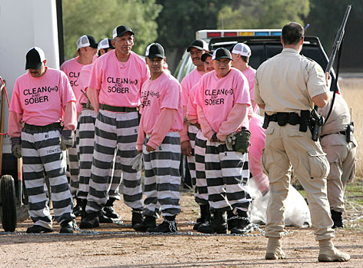
http://www.tarncourt.co.uk/sillies/sillies/web/sheriff-joe.htm

Slide 5
Saving money.
The average annual operating cost per state inmate in 2001 was $22,650, or $62.05 per day;
Sheriff Joe Arpaio created the 'tent city jail' to save Arizona from spending tens of millions of dollars on another expensive prison complex.
He banned smoking and pornographic magazines in the jails, and took away their weightlifting equipment and cut off all but 'G' movies.
He says: 'They're in jail to pay a debt to society not to build muscles so they can assault innocent people when they leave.‘
He started chain gangs to use the inmates to do free work on county and city projects and save taxpayer's money.
http://www.quora.com/How-much-money-does-one-prisoner-cost-per-year
http://www.tarncourt.co.uk/sillies/sillies/web/sheriff-joe.htm

Slide 6
Make Prisoners never want to come back
He cut off coffee because it has zero nutritional value and is therefore a waste of taxpayer money. When the inmates complained, he told them, 'This isn't the Ritz/Carlton. If you don't like it, don't come back.
temperatures reached 128 degrees. 'This is hell. It feels like we live in a furnace,' said Ernesto Gonzales, an inmate for 2 years with 10 more to go. 'It's inhumane.
Joes response 'Criminals should be punished for their crimes - not live in luxury until it's time for parole, only to go out and commit more crimes so they can come back in to live on taxpayers money and enjoy things many taxpayers can't afford to have for themselves.‘
7 out of 10 released inmates will find themselves back in prison
http://en.wikipedia.org/wiki/Recidivism
http://www.tarncourt.co.uk/sillies/sillies/web/sheriff-joe.htm

Slide 7
Tell me you don’t agree..
The same day joe told all the inmates who were complaining of the heat in the tents: 'It's between 120 to 130 degrees in Iraq and our soldiers are living in tents too, and they have to walk all day in the sun, wearing full battle gear and get shot at, and they have not committed any crimes, so shut your damned mouths!'
http:www.tarncourt.co.uk/sillies/sillies/web/sheriff-joe.htm
//

Slide 8
Youtube video
http://www.youtube.com/watch?v=_1tfIKUZ0fY

Slide 9
RECAP
THIS PRISON IS DIFFERENT !
THIS PRISON SAVES MONEY!
THIS PRISON WILL KEEP PEOPLE FROM WANTING TO GO BACK!

Slide 10
Work cited
video http://www.youtube.com/watch?v=_1tfIKUZ0fY
Info:
http://www.tarncourt.co.uk/sillies/sillies/web/sheriff-joe.htm
http://en.wikipedia.org/wiki/Recidivism
http://www.quora.com/How-much-money-does-one-prisoner-cost-per-year

Slide 11
QUESTIONS????
CONTACT ME AT CMM6002@psu.edu
http://www.google.com/imgres?imgurl=http://www.everything2me.net/wp-content/uploads/2010/11/Question-marks.jpg&imgrefurl=http://www.everything2me.net/2010/11/to-know-or-not-to-know-that-is-the-question/question-marks/&

